Slide 1

BCA Ist Semester Introduction of Logic Circuit and Digital Design(ILCDD) Course Code: BCAC0003
Presented by:
Mr.Anuj Kumar
Assistant Professor, Dept. Of CE&A
GLA University, Mathura

Slide 2
Arithmetic operations of Binary
Rules for Addition:-
0+0=0
0+1=1
1+0=1
1+1=0 (1 Carry)
101010 (42)
+ 110011 (51)
1011101 (93)

Slide 3
Rules for Subtraction:-
0-0=0
0-1=1 with a borrow 1
1-0=1
1-1=0
1110 14
1011 11
0011 3

Slide 4
Rules for Multiplication:-
0*0=0
0*1=0
1*0=0
1*1=1
1010 (10)
*11 (3)
1010
1010#
11110 (30)

Slide 5
Representation of Binary Numbers
Binary numbers comprises in two groups.
Unsigned Numbers
Signed Numbers
Unsigned Numbers:- It contains only magnitude of the number .they do not have any sign.
That means all Unsigned binary numbers are positive .
As in decimal number system ,the placing of the +Ve Sign in front of the number is optional.
Example:-(108)₁₀ =(1101100)₂ here 7 bits represent the magnitude of number 108.

Slide 6
Signed Numbers:- It contains both sign and magnitude of the number.
The sign is placed in front of number +Ve sign for positive number and – sign for negative number.
In binary, sign bit is 0 indicates the number is positive and if sign bit is 1 means the number is negative.

Slide 7
Representation of signed binary numbers
MSB is used to indicate the sign of the number , it is also called sign bit.
If signed binary numbers contains N bits then (N-1) bits only represent the magnitude of numbers.
Three types of representation for signed binary numbers.
Sign- Magnitude form
1’^{S} Complement form
2’^{S} Complement form

Slide 8
Sign-Magnitude form
Example :- Positive number (108)
Binary equivalent of this number is (1101100) Which contains 7 bits.
Sign binary representation of this number is
(+108)= 0 1101100
(-108)= 1 1101100
Sign bit
Magnitude
Sign bit
Magnitude

Slide 9
1’^{S} Complement form
Example :- Negative number (-108)
We know the Signed Binary representation of 108 is (01101100).
Replace all Zero’s by One and all One’s by Zero’s.
01101100
10010011 =(-108) 1’s Complement of (108)₁₀

Slide 10
2’^{S} Complement form
The 2’^{S} Complement form of a binary number is obtained by adding one to the 1’^{S} Complement of signed binary number.
Example:-
2’^{S} Complement of (108)=1’^{S} Complement of (108) +1
Binary of 108 = 01101100
1’^{S} Complement of (108) = 10010011
+1
=(10010100)

Slide 11
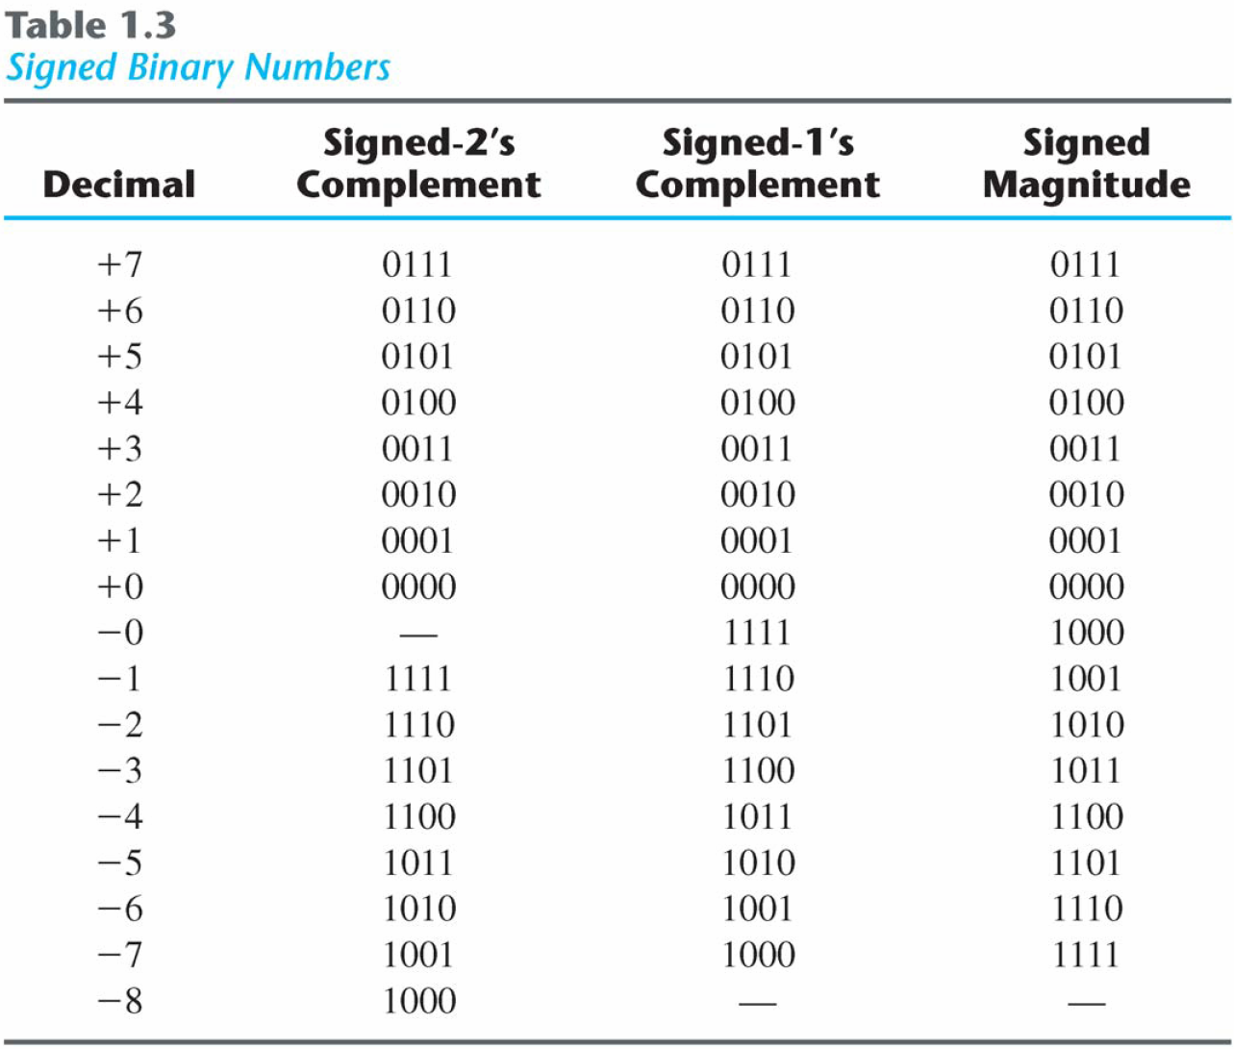
Signed Binary Numbers

